Slide 1
CSC-257 Theory Of Computation (BSc CSIT, TU)
Ganesh Khatri
kh6ganesh@gmail.com

Slide 2
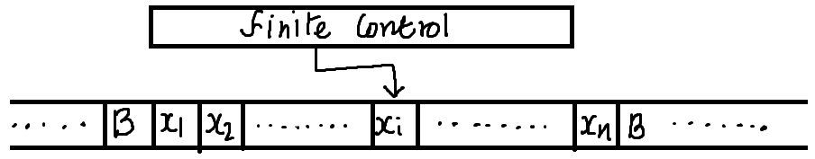
Chapter 6 - Turing Machine
Turing machine is an abstract machine developed by an English Mathematician Alan Turing in 1936.
The model of computation provides a theoretical foundation for modern computers.
Turing machine accepts the languages generated by type 0(unrestricted) grammars.
Turing machine will have :
A finite set of alphabets
A finite set of states
A linear tape which is potentially infinite to both end

Slide 3
Turing Machine(TM)
The tape is marked off into squares, each of which can hold one symbol from the alphabet.
If there is no symbol in the square then it contains blank.
The reading and writing is done by a tape head. The tape serves as :
Input device (input is simply the string assumed to this)
The memory available for use during computations
The output device (output is the string of symbols left on the tape at the end of computation).
A single move of Turing machine is function of the state of TM and the current tape symbol and it consists of three things :
Replacing the symbol in the current square by another, possibly different symbol
Moving the tape head one square right or left or leaving it where it is
Moving from current state to another, possibly different state

Slide 4
Difference between TM and Other Automata (FSA and PDA)
The most significant difference between the TM and the simpler machine (FSA or PDA) is that - in a Turing Machine, processing a string is no longer restricted to a single left to right pass through input.
The tape head can move in both directions and erase or modify any symbol it encounters.
The machine can examine part of the input, modify it, take time to execute some computation in a different area of the tape, return to re-examine the input, repeat any of these actions and perhaps stop the processing before it has locked at all input.

Slide 5
Turing Machine(TM) : Formal Definition
A Turing Machine M is defined by the seven-tuples, M = (Q, Σ, Г, δ, q0, B, F) where,
Q = the finite set of states of the finite control
Σ = the finite set of input symbols
Г = the complete set of tape symbols; Σ is always a subset of Г
q0 = the start state; q0 ε Q
B = the blank symbol; B ε Г but B does not belong to Σ.
F = the set of final or accepting states; F is subset of Q
δ = the transition function defined by :
Q × Г → Q × Г × (R, L, S) ; where R, L, S is the direction of movement of head left, or right or stationary. i.e. δ(q, X) = δ(p, Y, D); which means TM in state q and current tape symbol X, moves to next state p, replacing tape symbol X with Y and move the head either direction or remains at same cell of input tape.

Slide 6
Instantaneous Description for TM
The configuration of a TM is described by Instantaneous description(ID) of TM as like PDA
A string x₁x₂ ……………..x_{i-1} q x_{i}x_{i+1} ……….. x_{n} represents the ID of TM in which :
q is the state of TM
the tape head scanning the i^{th} symbol from the left
x₁x₂ ………… x_{n} is the portion of tape between the leftmost and rightmost non-blank.(If the head is to the left of leftmost non blank or to the right of rightmost non-blank then some prefix or suffix of x₁x₂ ……x_{n} will be blank and i will be 1 or n respectively.)

Slide 7
Moves of TM
The moves of a TM, M = (Q, Σ, Г, δ, q0, B, F) is described by the notation ⊢ for single move and by ⊢* for zero or more moves as in PDA.
For δ(q, x_{i}) = (P, Y, L) i.e. next move is leftward then, x₁x₂ ……… x_{i-1} q x_{i}x_{i+1} …….. x_{n} ⊢ x₁x₂ ….x_{i-2} P x_{i-1}Y x_{i+1} …… x_{n} reflects the change of state from q to p and the replacement of symbol x_{i} with Y and then head is positioned at i-1 (next input scan is x_{i-1})
If i = 1, M moves to the left of x₁ i.e. q x₁x₂ ……… x_{n} ⊢ p B Y x₂ ……. x_{n}
If i = n and Y = B, then M moves to state p and symbol B written over x_{n} joins the infinite sequence of trailing blanks which does not appear in next ID as : x₁x₂ …….. x_{n-1} q x_{n} ⊢ x₁x₂ ……… x_{n-2} p x_{n-1}

Slide 8
Moves of TM
The moves of a TM, M = (Q, Σ, Г, δ, q0, B, F) is described by the notation ⊢ for single move and by ⊢* for zero or more moves as in PDA.
If δ(q, x_{i})= (P, Y, R) i.e. next move is rightward then, x₁x₂ ……. x_{i-1} q x_{i} ……….. x_{n} ⊢ x₁x₂ …… x_{i-1} Y p x_{i+1} …….. x_{n}, which reflects that the symbol x_{i} is replaced with Y and head has moved to cell i+1 with change in state from p to q
If i= n, then i+1 cell holds blank which is not part of previous ID; i.e. x₁x₂ ……… x_{n-1} q x_{n} ⊢ x₁x₂ ……… x_{n-1} Y p B
If i = 1 and Y = B, then the symbol B written over x_{i} joins the infinite sequence of leading blanks and does not appear in next ID; i.e. qx₁x₂ ………. x_{n} ⊢ px₂ x₃ ………… x_{n}

Slide 9
Turing Machine
Example : Consider a TM that will accept the language { 0^{n}1^{n} | n >=1 }
Initially, it is given a finite sequence of 0’s and 1’s on its tape, preceded and followed by an infinity of blanks
The TM will change 0 to an X and then a 1 to Y until all 0’s and 1’s are matched
Starting at left end of the input, it repeatedly changes a 0 to an X and moves to the right over whatever 0’s and Y’s it sees until comes to a 1
It changes 1 to a Y, and moves left, over Y’s and 0’s until it finds X
At that point, it looks for a 0 immediate to the right. If finds a 0 then changes it to X and repeats the process, changing a matching 1 to a Y.

Slide 10
Turing Machine
Example : Consider a TM that will accept the language { 0^{n}1^{n} | n >=1 }
Algorithm :
Change '0' to 'X'
Move right to first '1'
Change '1' to 'Y'
Move left to leftmost '0'
Repeat the above steps until no more 0’s and 1’s remain in the tape

Slide 11
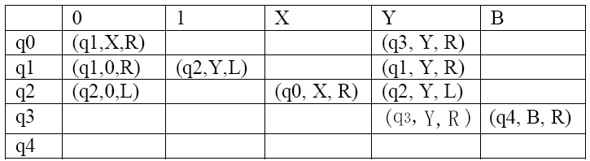
Turing Machine
The Turing Machine will look like :
M = ( {q0, q1, q2, q3, q4}, {0, 1}, {0, 1, X, Y, B}, δ, q0, B, {q4} )
The transition rule for the move of M is described by following transition table :

Slide 12
Turing Machine : Transition Diagram
A transition diagram of TM consists of :
A set of nodes representing states of TM.
An arc from any state, q to p is labeled by the items of the form X / YD, where X and Y are tape symbols, and D is a direction, either L or R. i.e. whenever δ(q, x) = (P, Y, D), we find the label x / YD on the arc from q to p.
However, in diagram, the direction D is represented by ← for left (L) and → for right (R)

Slide 13
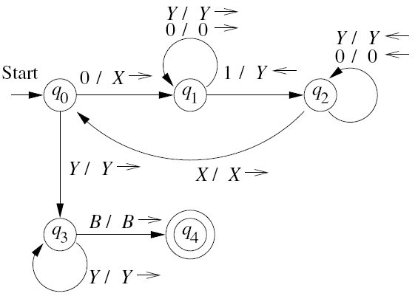
Turing Machine : Transition Diagram
transition diagram for the TM for L = {0^{n}1^{n} / n ≥ 1} is :

Slide 14
Turing Machine : Transition Diagram
Now, the acceptance of input 0011 by the TM, can be described by following sequence of moves
q₀ 0011 ⊢ X q₁ 011
⊢ X 0 q₁ 11
⊢ X q₂ 0 Y 1
⊢ q₂ X 0 Y 1
⊢ X q₀ 0 Y 1
⊢ XX q₁ Y 1
⊢ XXY q₁ 1
⊢ XX q₂ YY
⊢ X q₂ XYY
⊢ XX q₀ YY
⊢ XXY q₃ Y
⊢ XXYY q₃ B
⊢ XXYYB q₄ B ➔ Halt and accepted

Slide 15
Turing Machine : Transition Diagram
Example : Design a TM which recognizes the language L = 01*0
Solution : https://www.youtube.com/watch?v=D9eF_B8URnw

Slide 16
Turing Machine : Transition Diagram
More Examples :
https://www.javatpoint.com/examples-of-turing-machine

